Slide 1
H0201280 Talk-to-Code: Coding by Dictation
By: Lam Zhen Zong Nicholas
Project Supervisor: Assoc Prof. Ooi Wei Tsang

Slide 2
Objectives of the Project
Help people suffering from Carpal Tunnel Syndrome (CTS) to write code. [CTS is also known as Repetitive Strain Injury]
CTS – medical condition affecting median nerves of the hand
Programmers type code repeatedly for long hours.
Assist programmers to write code hands-free
This project allows users to write a program by voice
Notes:
CTS-medical : CTS causes pain to the user.
Programmers-type : This affects programmers the most, as they are required to perform repetitive tasks like typing code for a long period of time.
Assist-programmers: Programmers not suffering from CTS will not contract it and programmers suffering from CTS are able to write code once again.

Slide 3
Literature Review
Two Approaches
Command based approach
Natural language based approach

Slide 4
Command Based Approach
VoiceCode.io (example)
By Ben Meyers, programmer suffering from CTS
Program where user use voice to control computer in real-time.
Emails, switch between applications, etc.
User’s speech in form of a command
E.g. “Doon twenty-one” → press down-arrow key 21 times.

Slide 5
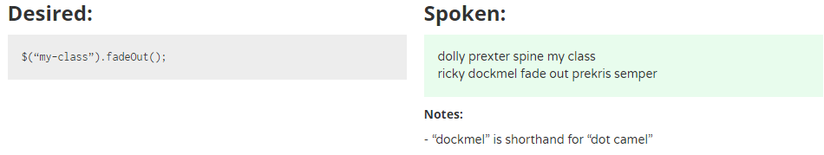
Command Based Approach
VoiceCode.io (example)
Example of spoken command for jQuery:

Slide 6
Command Based Approach
VoiceCode.io (example)
Strength: used for any programming language (because low-level building blocks used)
Limitations:
Steep learning curve (non-natural language words)
Lower productivity levels
Learning points:
Need more natural English words
Notes:
Steep learning curve – hard to remember , take lots of time to issue correct command for code.
Low productivity – additional time to learn new language or look at reference sheet. → time better spent doing something more productive
Learning point – easier to remember and smoothen the learning curve.

Slide 7
Natural language based approach
Spoken Java (example)
By Andrew Begel and Susan L. Graham
Their motivation: help CTS programmers
Program where user use voice to code in natural way instead of typing.
They found that existing solutions not natural enough for programmers.

Slide 8
Natural language based approach
Begel’s research: Challenges with voice-based programming
Speech is ambiguous in nature
Homophones (same pronunciation, different spellings)
Sentences can sound like asking question or making statement
Stop words (“uh”, “um”, “erm”)
Notes:
According to Begel’s research before he develop the Spoken Java program, he found …
Example for homophones ( I vs eye, to vs two)
Difficult to interpret by computers.

Slide 9
Natural language based approach
Begel’s research: Challenges with voice-based programming
Programming languages and tools were not meant to be ambiguous
They are designed to be read by computers (not humans)
Required to be precise, contain all punctuations
Contrary to the nature of speech (ambiguous)
Notes:
Required to be precise – so that compiling and running of the program code can be very efficient and feasible in implementation.
Therefore, difficult to translate speech into programming languages as speech is ambiguous while programming languages cannot afford to be ambiguous.

Slide 10
Natural language based approach
Begel’s research: Challenges with voice-based programming
Speech tools are not suitable for programming tasks
Speech recognizers designed for creating / editing text documents
Training of Speech recognizers done to support word processing tasks.
Word processing tasks ≠ Programming tasks
Notes:
Programming tasks such as create, edit, navigate through programs.
Thus, speech tools not suited for programming.

Slide 11
Natural language based approach
Begel’s research: Challenges with voice-based programming
Using voice for software development is something new for programmers
Programmers very used to keyboard
Difficult to adapt to switching (time and effort needed)

Slide 12
Natural language based approach
Begel’s experiment: How programmers verbalize code
Spoken words are hard to write down
Homophones (same word recognized differently by Speech Recognizer)
Capitalization not explicitly verbalized.
Ambiguity of spaces between words. ( “drop stack process” vs “dropStackProcess” )
Notes:
Conduct an experiment with 10 expert programmers to read java code. Points found out…
Capitalization not verbalized – problems as many programming languages are case sensitive.

Slide 13
Natural language based approach
Begel’s experiment: How programmers verbalize code
Structural ambiguities
User tends to omit punctuation when spoken.
Dot in object.stack
Parentheses in method call like “e.printStackTrace()”
Punctuations important to precisely mark our different program structures.

Slide 14
Natural language based approach
Begel’s experiment: How programmers verbalize code
Abstraction by programmers
Natural and common to speak in higher-level code
Example: “Set all the fields of array to null”
This is worth looking at in the future as it can improve productivity (1 phrase → many lines of code)
Notes:
Natural and common for programmers to speak in high level code instead of low level constructs, this is in spite of them being asked to verbalize program code and not paraphrase visible patterns.
Example – instead of verbalizing it explicitly. (array index 0 equal null, array index 1 equal null and so on)
[Q&A only] Future – because high level code is quite ambiguous for computers to translate precisely.

Slide 15
Natural language based approach
Begel’s experiment: How programmers verbalize code
Disambiguation
English native speakers use prosody for disambiguation.
Example: “array sub i plus plus” for array[i]++ or array[i++]
Non-native speakers use their own native language’s prosody
Notes:
[e.g.] English native speakers utilize pause to indicate grouping of terms in that expression to differentiate above cases. Array sub I <pause> plus plus
Array sub <pause> I plus plus
Non-native – use their own native language prosody when speaking English → change meaning of word

Slide 16
Natural language based approach
Spoken Java (example)
Using their experiment results → design and create Spoken Java
Match closely to how programmers verbalize code
Made improvements to their program to address issues from study.

Slide 17
Natural language based approach
Spoken Java (example)
Has an analysis framework – Harmonia
Analyzes texts translated by Speech recognizer
Harmonia handles homophones, miscapitalized words and concatenated words by using contextual information.
Notes:
Harmonia handles – by using contextual info to perform disambiguation and choose the proper interpretations to translate Spoken Java into Java code.
[Note only] Spoken Java is also defined by a lexical specification which allows for different ways of verbalizations to match the same construct.

Slide 18
Natural language based approach
Limitations in Begel’s study
Lack of feedback
Program spoken in linear fashion
Different programming styles
Coding does not involve reading from script
Notes:
Lack of feedback – programmers receive no feedback of their current state when verbalizing the code → know nothing about program correctness. → prevent them from understanding how programmers would verbally edit code.
Linear fashion – this is unlike how programmers will write code → where they might go front and back when writing code.
Diff programming styles – some prefer modular programming, some prefer planning interface first before writing code. All these styles require speech system and analysis of partial code, which is unsupported by Spoken Java.
Reading from script – coding involves writing code on the fly. This action of spontaneous voice-based coding can show us how programmers will edit or code in a non-linear manner. Begel study doesn’t do this and we do not know what kind of error and ambiguities will surface.

Slide 19
Natural language based approach
Limitations in Begel’s study
Learning points
Important to eliminate ambiguities
Importance of feedback
How programmers verbalize code
Notes:
Eliminate ambiguity – programming language is precise, and we have to restrict what the user can say to achieve this
Importance of feedback – so that programmer will know current progress and correctness of program
Verbalize code – omit punctuations and ambiguity , so we need to have a more structured language to handle these cases

Slide 20
Project Overview
End-to-end program which converts user’s voice into program code.
Using structured language
Notes:
Structured language – Ambiguities like : different programmers might have more than one way of saying same code
Please refer to given handout for structured language

Slide 21
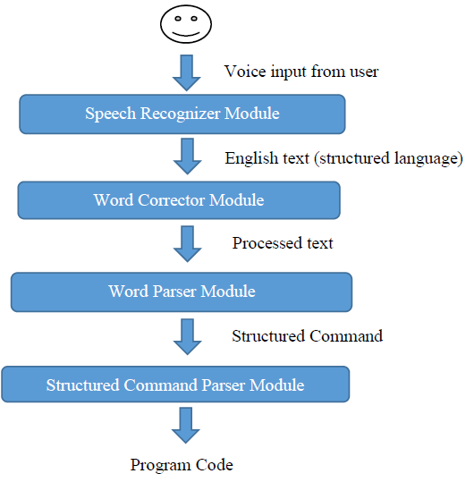
System Architecture

Slide 22
declare float money equal three point two and declare
declare float money equal three point two end declare
#create float #variable money #value 3.2 #dec_end;;
float money = 3.2;

Slide 23
Speech Recognizer module
Converts voice input into English text.
Using python Speech Recognition library
Supports several APIs
Experiment on the APIs

Slide 24
Speech Recognizer module
Experiment with basket of keywords:
Keywords | Google Speech Recognition | Google Cloud Speech API | Microsoft Bing Voice Recognition | Total
Equal | 7 / 10 | 9 / 10 | 6 / 10 | 22 / 30
If Then Else | 5 / 10 | 5 / 10 | 5 / 10 | 15 / 30
End If | 0 / 10 | 5 / 10 | 0 / 10 | 5 / 30
Declare integer | 5 / 10 | 7 / 10 | 0 / 10 | 12 / 30
Size | 6 / 10 | 9 / 10 | 8 / 10 | 23 / 30
Index | 9 / 10 | 10 / 10 | 10 / 10 | 29 / 30
Create Function | 4 / 10 | 9 / 10 | 6 / 10 | 19 / 30
Return Type | 1 / 10 | 8 / 10 | 2 / 10 | 11 / 30
Parameter | 3 / 10 | 9 / 10 | 1 / 10 | 13 / 30
Call | 5 / 10 | 5 / 10 | 10 / 10 | 20 / 30
For | 0 / 10 | 0 / 10 | 0 / 10 | 0 / 30
Plus plus | 5 / 10 | 6 / 10 | 7 / 10 | 18 / 30
While | 0 / 10 | 4 / 10 | 0 / 10 | 4 / 30
Switch case end switch | 0 / 10 | 0 / 10 | 0 / 10 | 0 / 30
Dot | 2 / 10 | 4 / 10 | 0 / 10 | 6 / 30
Notes:
After coming up with the first draft of my own structured language, I have picked out some of the keywords and conducted an experiment with 10 participants.
They were asked to record their voice into an audio file which consists of the keywords, and then these audio files passed through my speech recognizer.
From the figure above, it can be noted that Google Cloud Speech API consistently performs better than the other two in most of the cases of keywords.
The difference between Google Speech Recognition and Google Cloud Speech API lies within the fact that the latter allows for a list of preferred phrases to be passed into the recognition process, which greatly enhances the accuracy of the speech recognition.
On the other hand, Microsoft Bing Voice Recognition seem to be only accurate for a few keywords and is largely inaccurate for most of the keywords involved.

Slide 25
Speech Recognizer module
Experiment with script for sample program:
 | Google Speech Recognition | Google Cloud Speech API | Microsoft Bing Voice Recognition | Total
Total | 389 / 640 | 423 / 640 | 247 / 640 | 1059 / 1920
Notes:
Previous experiment focuses more on keywords as a starting point for our analysis.
However, the actual recognition process would require user to speak in complete sentences. “declare integer count equal zero” and NOT “declare integer”
So I conducted another experiment, in which a script for finding maximum number in integer array was written using my structured language, for the same 10 participants
The numbers above confirms Google Cloud Speech API produces the most accurate results over the other two APIs.
I have also observed from the raw data of the results that Microsoft Bing Voice Recognition is more suitable for recognizing proper complete English sentences than user-defined structured language.
As such, I have decided on the use of Google Cloud Speech API for my speech recognizer module.

Slide 26
Word Corrector module
Process input English text into processed English text.
Because Speech Recognition module is not perfect. (some words misinterpreted)
Phase 1: Correct commonly misinterpreted words
Phase 2: Correct variable names using contextual information.
Notes:
Contextual info about previously declared variables in variable or function declaration statements.

Slide 27
Word Corrector module
Phase 1
Utilize raw data results from earlier experiments to correct common misinterpretations
Example: End constructs often misinterpreted.
“End function” misinterpreted as “and function”
Notes:
Misinterpretations from speech recognizer.
Example – attempt to correct “and” into “end” if the word “and” appended with the following word will form a valid end construct.
Word Corrector module mainly targets the correction of keywords

Slide 28
Word Corrector module
Phase 2
Use contextual information about previously declared variables to do correction.
Variable | makes
Find most similar
Declared Variables
number
length
max
Notes:
I will illustrate this correction with a simple example.

Slide 29

Word Corrector module
Phase 2
Use contextual information about previously declared variables to do correction.
Variable | makes
Declared Variables
number
length
max
Encode(“number”)
Encode(“length”)
Encode(“makes”)
Encode(“max”)
Phonetic Encoding with American Soundex
Notes:
This is done with the aid of jellyfish python library, which does approximate and phonetic matching of strings.
First, we will convert all the words into their phonetic encodings using American Soundex.

Slide 30
Word Corrector module
Phase 2
Use contextual information about previously declared variables to do correction.
max
Declared Variables
number
length
max
Variable | makes
0.0
Encode(“number”)
0.5
Encode(“length”)
Encode(“makes”)
Encode(“max”)
0.85
Compare with Jaro-Winkler Distance
Notes:
Then we will compare the resulting phonetic encodings with Jaro-Winkler Distance
to get a similarity index between each pair of words.
As the similarity index between “makes” and “max” is 0.85, which is the highest, “makes” will be replaced by “max”
[Q&A only] Jaro-Winkler distance: string metric for measuring the edit distance between two sequences. The Jaro distance between two words is the minimum number of single-character transpositions required to change one word into the other.]

Slide 31
Word Corrector module
About jellyfish python library
Many ways of Phonetic encoding
American Soundex
Metaphone
NYSIIS
Many ways of string comparisons
Levenshtein Distance
Damerau-Levenshtein Distance
Hamming Distance
Jaro Distance
Jaro-Winkler Distance
Notes:
As the jellyfish python library provides more than just one way of doing phonetic encoding and string comparisons, there is a need to test which pair of algorithms deliver better results.
It is preferable to have differentiable similarity indices between different pair of words (i.e. no ties in similarity index). After much testing, I have found that American Soundex and Jaro-Winkler Distance are the best fit for this purpose.
It is also notable that the way which we use to find the closest matching pair of words is actually a heuristic and not an algorithm. This is due to the fact that it is difficult to truly tell which word is closer to a particular target word. For instance, if we have already declared the variables “eye”, “ai”, “aye” and we need to correct the word “i”, which of these 3 variables would we deem as closest matching to the word “i”. However, this heuristic is good enough for the purposes of this program in most instances, after testing the program with our script for the sample program from our earlier experiment.

Slide 32
Limitations !!!

